Slide 1
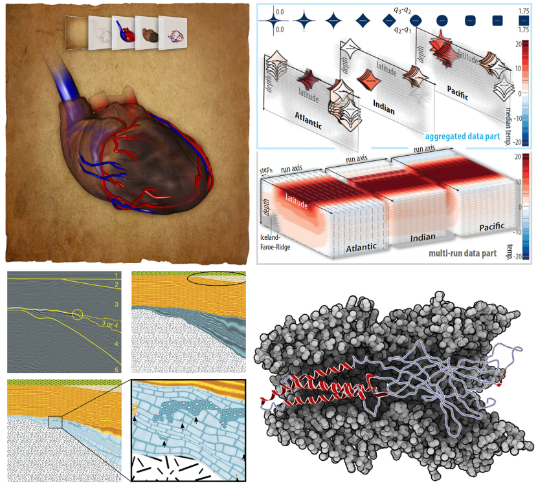
Open PhD Fellowship @ UiB
4-Year PhD position, much freedom for creativity
Background (e.g., master’s thesis) in visualization
Good GPU programming skills
Application deadline: July 10, 2013
More information: http://www.ii.uib.no/vis

